Slide 1
Reducing Flood-Related Financial Loss
Gabriel Duffy

Slide 2
Understanding Flood-Related Damage and its Impact
Climate Change
Preventive Measures
Financial Loss
Weather is constantly changing
850 billion dollars of damages since 2000
Flood Maps are outdated

Slide 3
Objectives
Use predictive modeling to identify which areas are at highest risk of flooding
Create and implement advisory board in at-risk areas
Reduce flooding-based loss/damage
Better communication
Access to aid

Slide 4
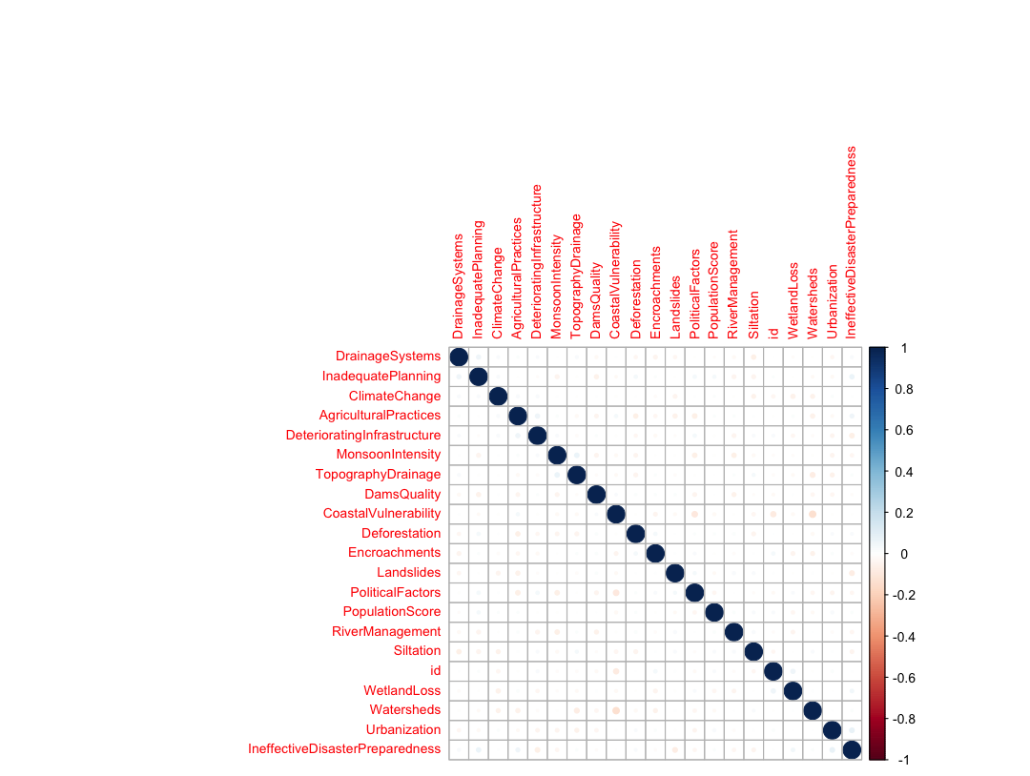
Data Visualization-Multicollinearity

Slide 5
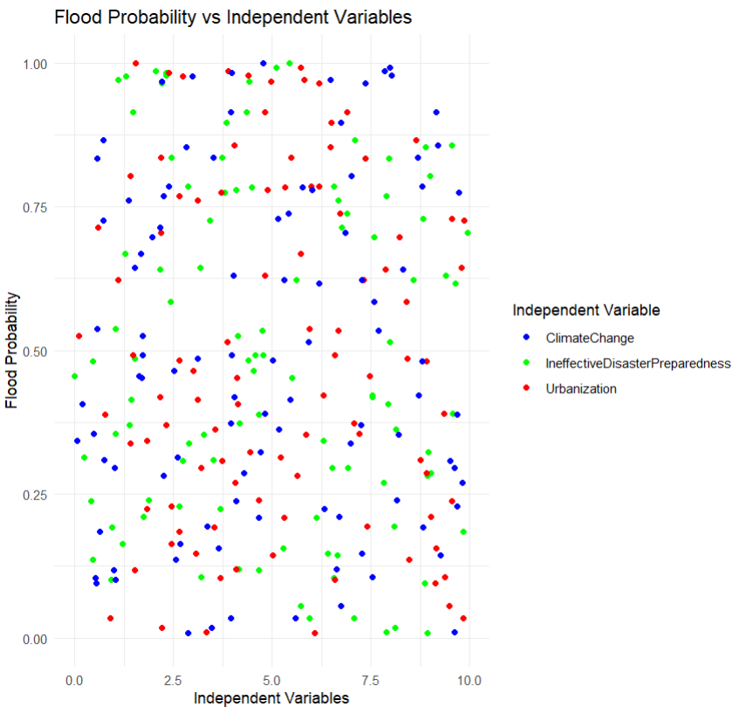
Data Visualization-Scatter Plot

Slide 6
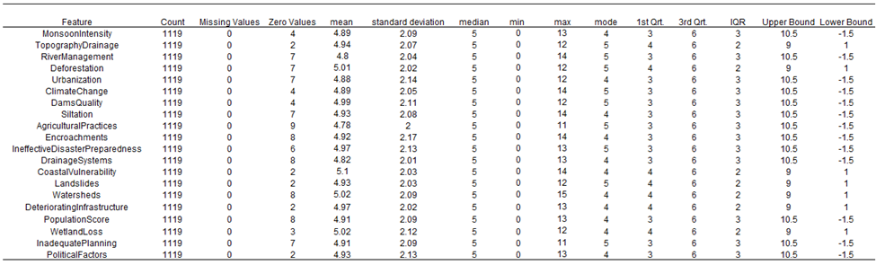
Data Visualization-Data Quality Report

Slide 7
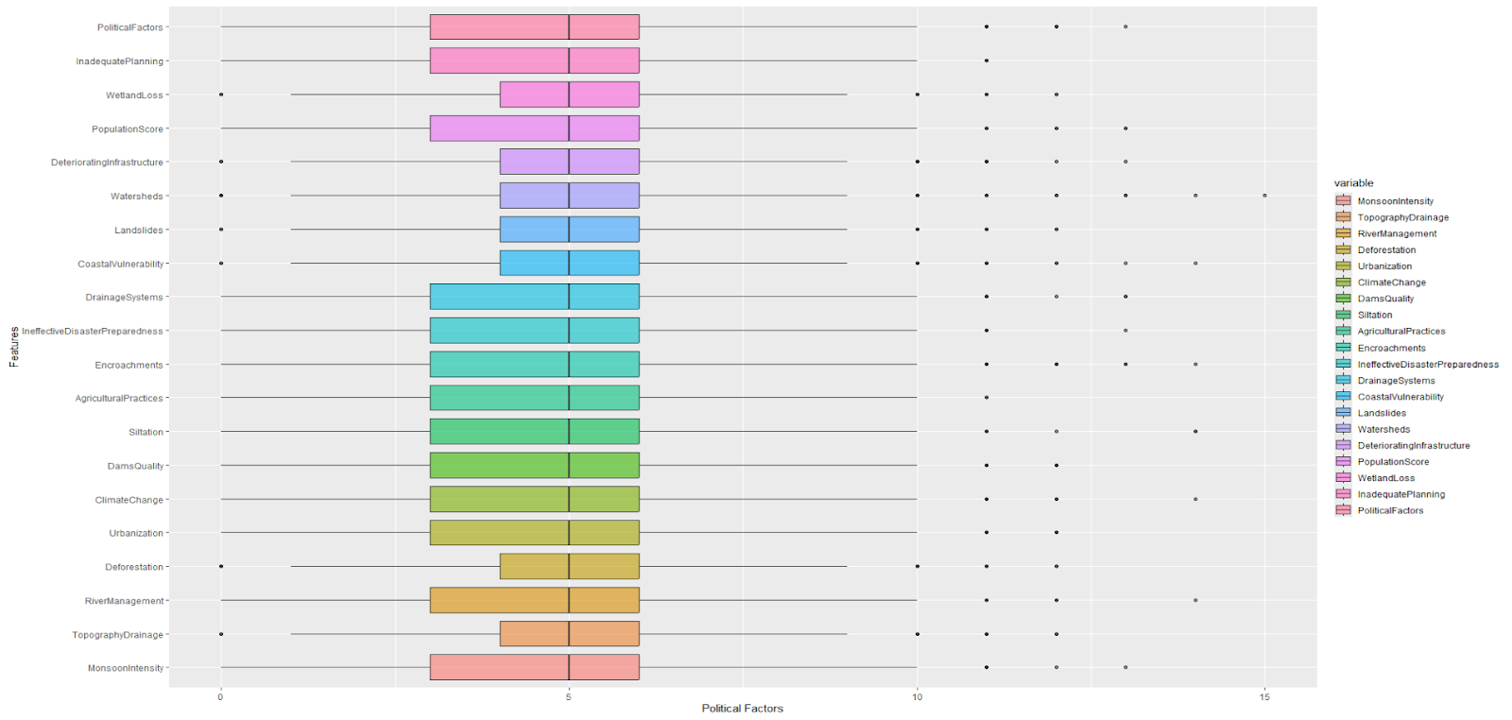
Data Visualization-Data Quality Outlier

Slide 8
Project Phases
Domain Knowledge and Data
Deployment and Future Steps
Model Building
Research key terms
Study recent trends of floods and financial loss
Complete data cleaning and preprocessing
Complete EDA
Consider model assumptions
Create initial models and assess performance
Deploy the best-performing model
Present findings to business leaders
Initiate advisory board work

Slide 9
Constraints, Assumptions, Considerations
Considerations
Assumptions
Constraints
Cost of cutting-edge and proactive data collection
Data security and privacy
Up-to-date data
Error-free data collection
Continual government and populace support
Local and state government permissions
Number of qualified candidates for advisory board

Slide 10
KPIs
Flood Damage Reduction Rate:
Baseline Flood Damage Costs: $10,000,000
Current Flood Damage Costs: $9,000,000
Reduction: (10,000,000−9,000,000)/10,000,000×100=10%(10,000,000 - 9,000,000) / 10,000,000 \times 100 = 10\%(10,000,000−9,000,000)/10,000,000×100=10%
Accuracy of Flood Prediction Models:
Correct Predictions: 85
Total Predictions: 100
Accuracy: (85/100)×100=85%(85 / 100) \times 100 = 85\%(85/100)×100=85%
Response Time for Aid Deployment:
Total time for 5 flood events: 500 hours
Average Response Time: 500/5=100500 / 5 = 100500/5=100 hours
Target reduction: 20% of 100 hours = 80 hours

Slide 11
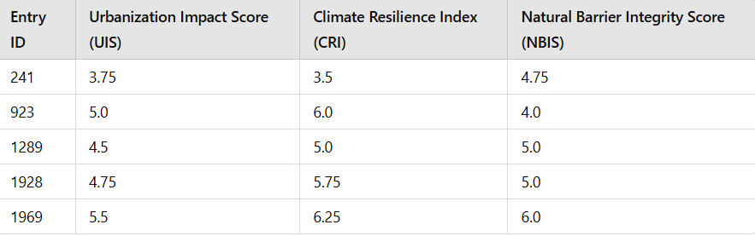
KPIs
Urbanization Impact Score (UIS): urbanization contributes significantly to flood risks, improve in urban planning and infrastructure improvements to mitigate flood damage.
Climate Resilience Index (CRI): Preparedness and resilience against climate impacts, prioritize investments in disaster readiness and resilience infrastructure to minimize flood damage.
Natural Barrier Integrity Score (NBIS): Effectiveness of natural barriers, identify and enhance natural defenses to reduce flood impact and associated costs.

Slide 12
Conclusion and Next Steps
Dataset is in optimal condition utilizing EDA techniques. Multicollinearity will need to be reviewed and potentially addressed.
Initial models need to be created and tested for performance before deployment
Budget will need to be allocated for constant extraction of data and equipment once model is deployed to maintain accuracy

Slide 13
Works Cited
Flooding is America’s most frequent and expensive disaster. (n.d.). https://www.flooddefenders.org/problem
Brunner, M. I., Slater, L., Tallaksen, L. M., & Clark, M. (2021). Challenges in modeling and predicting floods and
droughts: A review. WIREs. Water, 8(3). https://doi.org/10.1002/wat2.1520
United Nations. (n.d.). What is climate change? | United Nations.
https://www.un.org/en/climatechange/what-is-climate-change
National Geographic Society. (2024, February 21). Deforestation.
Education.nationalgeographic.org; National Geographic. https://education.nationalgeographic.org/resource/deforestation/

Slide 14
Works Cited
Encroachments. (2020, July 7). FEMA.gov.
https://www.fema.gov/glossary/encroachments#:~:text=Encroachments%20are%20activities%20or%20construction,substantial%20improvements%2C%20and%20other%20development.
Flood prediction factors. (2023b, December 25). Kaggle.
https://www.kaggle.com/datasets/brijlaldhankour/flood-prediction-factors/data
Floodway. (2020, July 8). FEMA.gov. https://www.fema.gov/glossary/floodway
What is a landslide and what causes one? | U.S. Geological Survey. (2016, December 31).
https://www.usgs.gov/faqs/what-a-landslide-and-what-causes-one

Slide 15
Works Cited
Costa, H. (2023, October 19). Monsoon. Education.nationalgeographic.org.
https://education.nationalgeographic.org/resource/monsoon/
Open Water. (n.d.). Rrt5.org.
https://rrt5.org/Tools/HabitatFactSheets/OpenWater.aspx#undefined
Siltation. (n.d.). Cumberland River Compact.
https://cumberlandrivercompact.org/problem/siltation/
Topography/Drainage - GK Technology For Agriculture. (2018, March 31). GK
Technology for Agriculture. https://gktechinc.com/topography-drainage/

Slide 16
Works Cited
National Geographic Society. (2022, May 20). Urbanization. National Geographic.
https://education.nationalgeographic.org/resource/urbanization/
Fisheries, N. (2022, April 26). What Is a Watershed? | NOAA Fisheries. NOAA.
https://www.fisheries.noaa.gov/new-england-mid-atlantic/habitat-conservation/what-watershed
US EPA. (2019, May 17). What is a Wetland? | US EPA. US EPA.
https://www.epa.gov/wetlands/what-wetland
Wetland Losses - An Overview of Coastal Land Loss: With Emphasis on the Southeastern United
States. (n.d.). Pubs.usgs.gov. https://pubs.usgs.gov/of/2003/of03-337/wetland.html#:~:text=Wetland%20losses%20involve%20conversion%20of

Slide 17
Thanks
Do you have any questions?
smithjones@dataconsulting.com
+1 555 505 5555
dataconsulting.com
Please keep this slide for attribution

